Slide 1
Style
Not what to say but How to Say it

Slide 2
Thinking out into Language
Lexis (Greek) – “Style”
Thought
Word
Speaking
Elocuto (Latin)– “Style”
Speaking Out

Slide 3
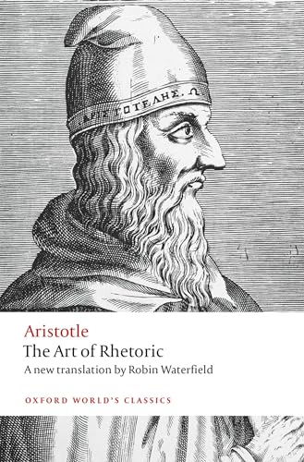
Aristotle and Style
Areté (Greek)
Excellence in function
…let a virtue of diction [style] be defined as clarity, for argument or speech is a sort of sign, such that if it is not clear, it will not perform the task that is its own; and let the diction (proper to rhetoric) be neither humble nor above the worth (of the subject matter in question) but appropriate to it.

Slide 4
Teaching Style in the Classical Way

Slide 5

Precepts/Principals (Ars)
Grammar
Vocabulary
Perspicuity
Syntax

Slide 6

Practice in Writing (Exercitatio)
Variation
Meaphrasis
Paraphrasis
Epitome

Slide 7
Progymnasmata
Fable
Law
Narrative
Thesis
Maxim
Greek work for “preliminary exercises”
Comparison
Cheria
Invective
Refutation / Confirmation
Enomium
Commonplace

Slide 8
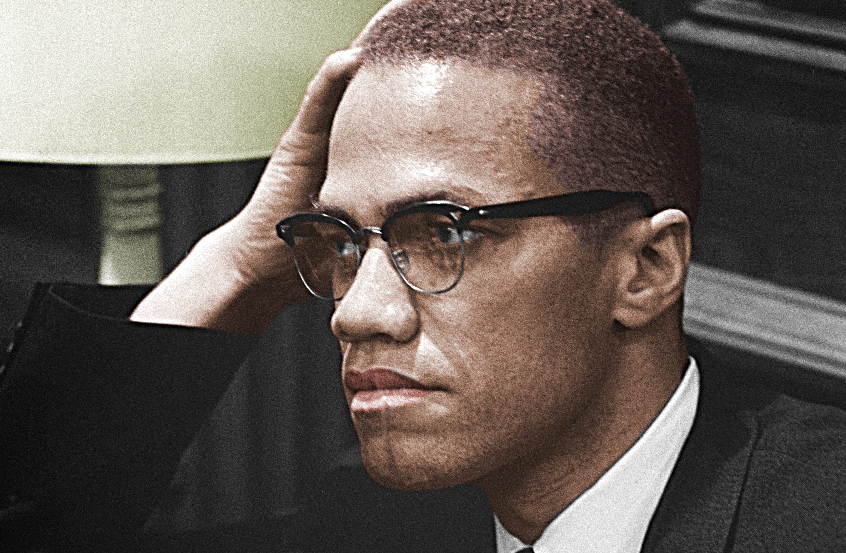
Imitation in Writing (Imitatio)
I saw that the best thing I could do was get hold of a dictionary—to study, to learn some words. I was lucky enough to reason also that I should try to improve my penmanship. It was sad. I couldn’t even write in a straight line. It was both ideas together that moved me to request a dictionary along with some tables and pencils from the Norfolk Prison Colony school.
[...]
I woke up the next morning, thinking about those words—immensely proud to realize that not only had I written so much at one time, but I’d written words that I never knew were in the world. Moreover, with a little effort, I also could remember what many of these words meant. I reviewed the words whose meanings I didn’t remember.

