Slide 1
Information Architecture

Slide 2
Defining Information Architecture
Usability – how well a user in a specific context can use a product/design to achieve a goal
The art and science of shaping information products and experiences to support usability, findability, and understanding
Findability – the ease of locating wanted information withing the particular platform or interface
Effective
Efficient
Engaging
Error Tolerant
Easy to Learn

Slide 3
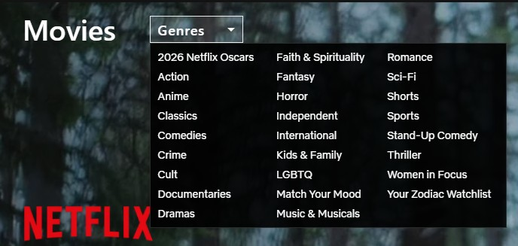
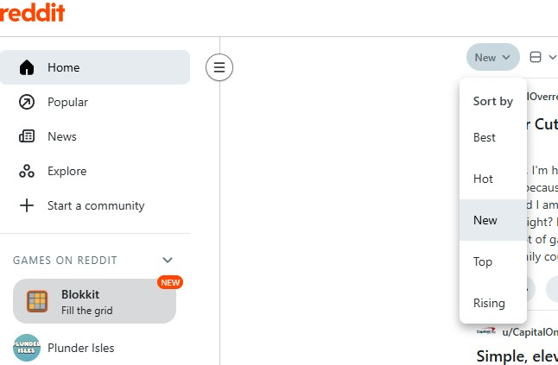
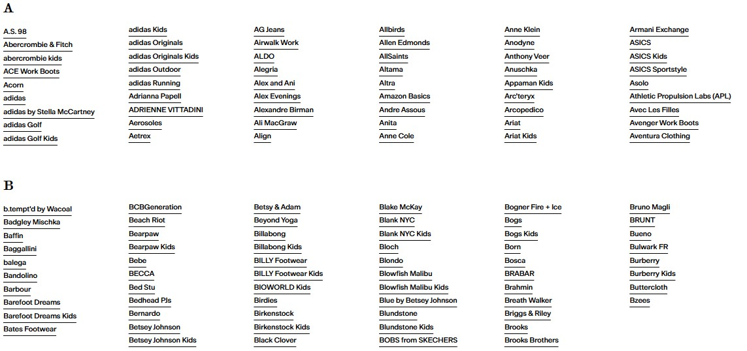

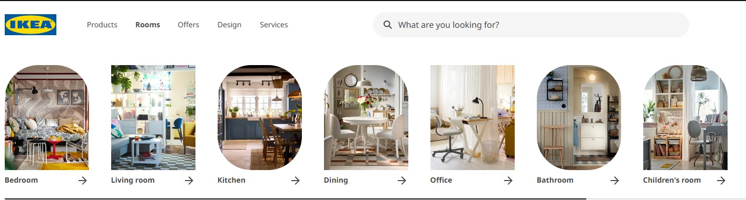
What else Can We Include?
The synthesis of organization, labeling, search, and navigation systems within digital, physical, and cross-channel ecosystems.
L.A.T.C.H.
Location
Alphabet
Time
Category
Hierarchy

Slide 4
The Foundations of Information Architecture

Slide 5
Context
Be familiar with the organization
Vocabulary and structure
Understanding and alignment

Slide 6

Content
The “stuff” – documents, applications, services
Things to keep in mind:
  Ownership
  Format
  Structure
  Metadata
  Volume
  Dynamism

Slide 7
Users
The people who will use your information environment
Questions to consider:
  Who is using your system?
  How are they using it?
  What information do they want from your system?

Slide 8
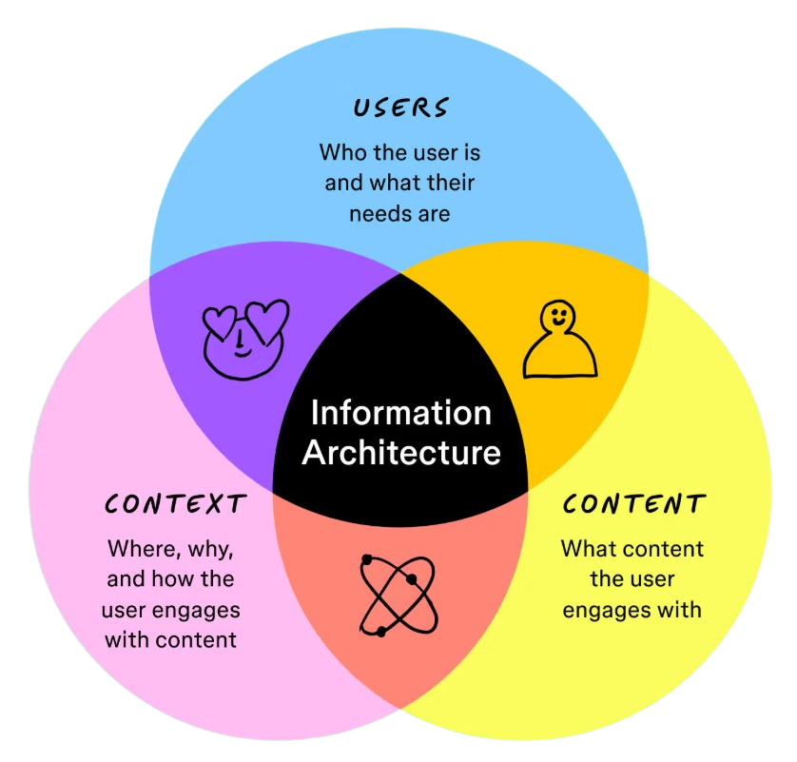

Slide 9
Example Questions for The Mid-Term

Slide 10
Multiple Choice
Periphrasis is:
  Using the briefest wording possible
  Expanding an idea instead of stating it in the shortest way, often for ornament
  Repeating the same word order
  Assigning sounds to new words
A rhetorical perspective is best described as:
  A strict set of grammar rules
  Orientations or attitudes that frame the way we think and see persuasive resources
  A list of political beliefs
  A method for collecting statistical data

Slide 11
Fill In The Blank
A __________ question is asked even though the rhetor does not really expect an answer, often to open space to say more.
*Rhetorical
According to Cicero, invention is the discovery of valid or seemingly valid __________ to render one’s cause plausible.
*Arguments

Slide 12
True / False
Stasis theory is a systematic way of asking questions about rhetorical situations.
True
Clarity (perspicuity) in style can be lost when a rhetor uses obsolete or highly technical words unnecessarily.
True

