Slide 1
Finishing the Canons

Slide 2
Memory

Slide 3
Seizing The Moment - Kairos
Linear Time
Chronos
Time
Situation
Kairos
Season

Slide 4
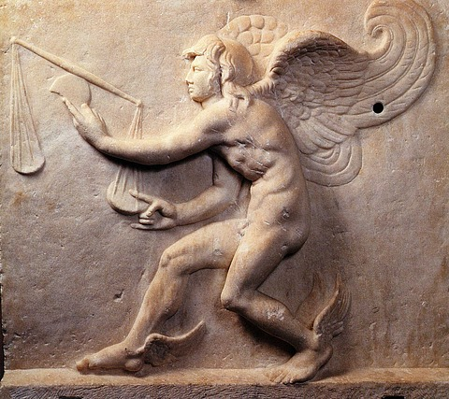
Caerus (Kairos)

Slide 5
Ancient Memory Systems
“Artificial Memory”
  Careful training
  Memory palaces
Dissoi Logi
  Focus
  Practice
  Connect

Slide 6
Modern Versions of Ancient Memory Systems
Cultural Memory
Organizational Memory
Literate Memory Systems

Slide 7
Delivery
Hypokrisis (Greek)
Actio (Latin)

Slide 8
Considerations for Spoken Delivery
Nonverbal
  Appearance
  Facial expression
  Posture
  Gestures
  Eye contact
  Movement
Verbal
  Rate
  Volume
  Pitch
  Enunciation
  Dramatic pause

Slide 9
Considerations for Written Delivery
Forms of academic writing
Rules of correctness
Textual presentation
Visual presentation

