Slide 1
Artistic Proofs

Slide 2
The Art of Rhetoric – Aristotle
Some proofs are inartificial and some are artificial. When I say that a proof is “inartificial,” I mean that it is not supplied by us, but pre-exists: examples are witnesses, statements obtained through torture, written contracts, and son on. When I say that a proof is “artificial,” I mean that it can be provide by our use of rhetorical method. The former, then, have to be used, but the latter must be invented.
Proofs that depend on the spoken word fall into three categories. Some rely on the speaker’s character, some on putting the listener in a certain frame of mind, and some on the argument itself, through demonstrating, or seeming to demonstrate something.

Slide 3
Ethos

Slide 4
According to Aristotle
Proof through character occurs when a speech is delivered in such a way as to make the speaker credible, since we trust good men more fully and more readily. In fact, not only do we trust them in general, whatever the issue, but we are even inclined to trust them completely in cases where certainty is out of the question and there is room for doubt. But even this kind of proof should be the result of what the speaker says, not of any preconceived notion about what kind of man he is. For it is not the case, whatever some authors of rhetorical manuals claim, that in rhetoric the goodness of the speaker makes no contribution towards persuasiveness; on the contrary, it is hardly an exaggeration to say that there is no more authoritative proof than character.

Slide 5
Invented Ethos
Creating a character
Most important when facts or arguments in doubt
Ethical mistakes
Lacks experience or information, therefore, they are unable to draw the correct conclusions
Even if they know the correct answer, they may hide it due to a character flaw such as greed
They do not care about what happens to the people they represent, therefore, they do not give good advice

Slide 6
What does a Rhetor Need to Be?
Seem Intelligent
Be of good moral character
Possess good will toward their audience
Cite approval from someone the audience already respects
Refrain from using unfair or inappropriate tactics (lying, threating, name calling)
Having respectable credentials or a lot of experience in a particular field
Informed about the issues they discuss
Refrain from using arguments that are irrelevant or trivial
Be sure not to overwhelm audiences with details
Be aware of how informed your audience is
  When you take the audience into consideration when crafting your speech or writing
  Explaining why you think your presentation of an argument is important and what benefits your audience will receive from it

Slide 7
Situated Ethos
Liking:
How well the people (audience and rhetor) who are engaging in a rhetorical situation like each other
Questions to consider:
  Are the feelings mutual among participants in this rhetorical situation or in arguments about the issue?
  How intense are these feelings? Could they be easily changed by rhetoric?
Power:
The capacity to exert interpersonal influence
Questions to consider:
  How different are the power positions of the various participants in a rhetorical act? Does the act increase, maintain or decrease the difference?
  How rigid or flexible is the power structure?
Distance
Degree of physical and social distance created between a rhetor and an audience
Questions to consider:
  What would it take to move someone towards acceptance or rejection of my position?
  Can I move someone from a position of rejection to acceptance?
The internal qualities of character
Having a good reputation in the community
Inartificial proof
3 important elements

Slide 8
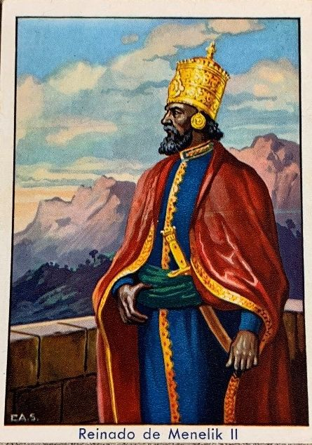
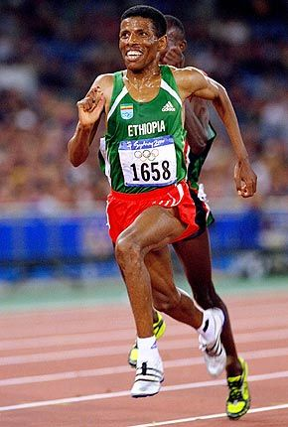
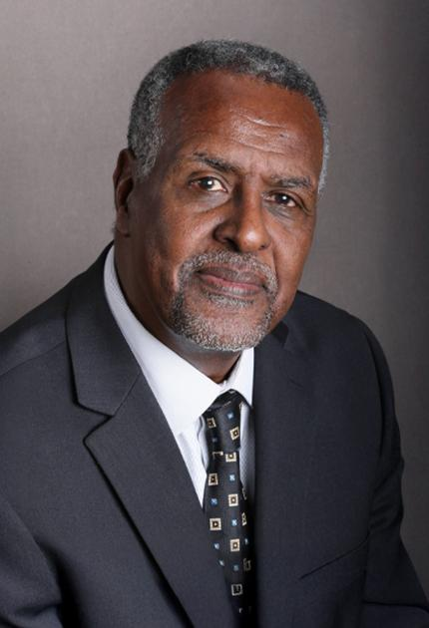
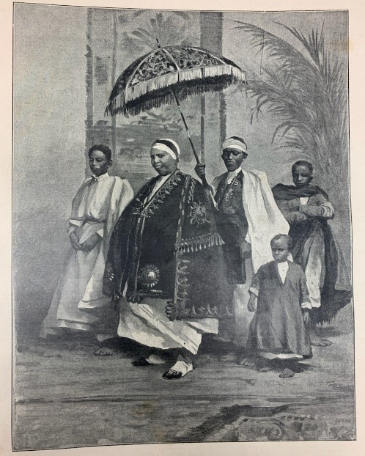
Ethiopians with Ethos
Emperor Menelik II
Haile Gebre-Selassie
Empress Taytu Betul
Gebisa Ejeta

Slide 9
Pathos

Slide 10
Appeals to Passion
Proof through the audience occurs when they are induced by what is said to feel some emotion, since we judge matters differently when we are sad or hostile from when we are happy or friendly. This, as I have been saying is in fact the only kind of proof that contemporary authors of rhetorical manuals attempt to treat. But I shall give a detailed account of this matter when I come to discuss the emotions.

Slide 11
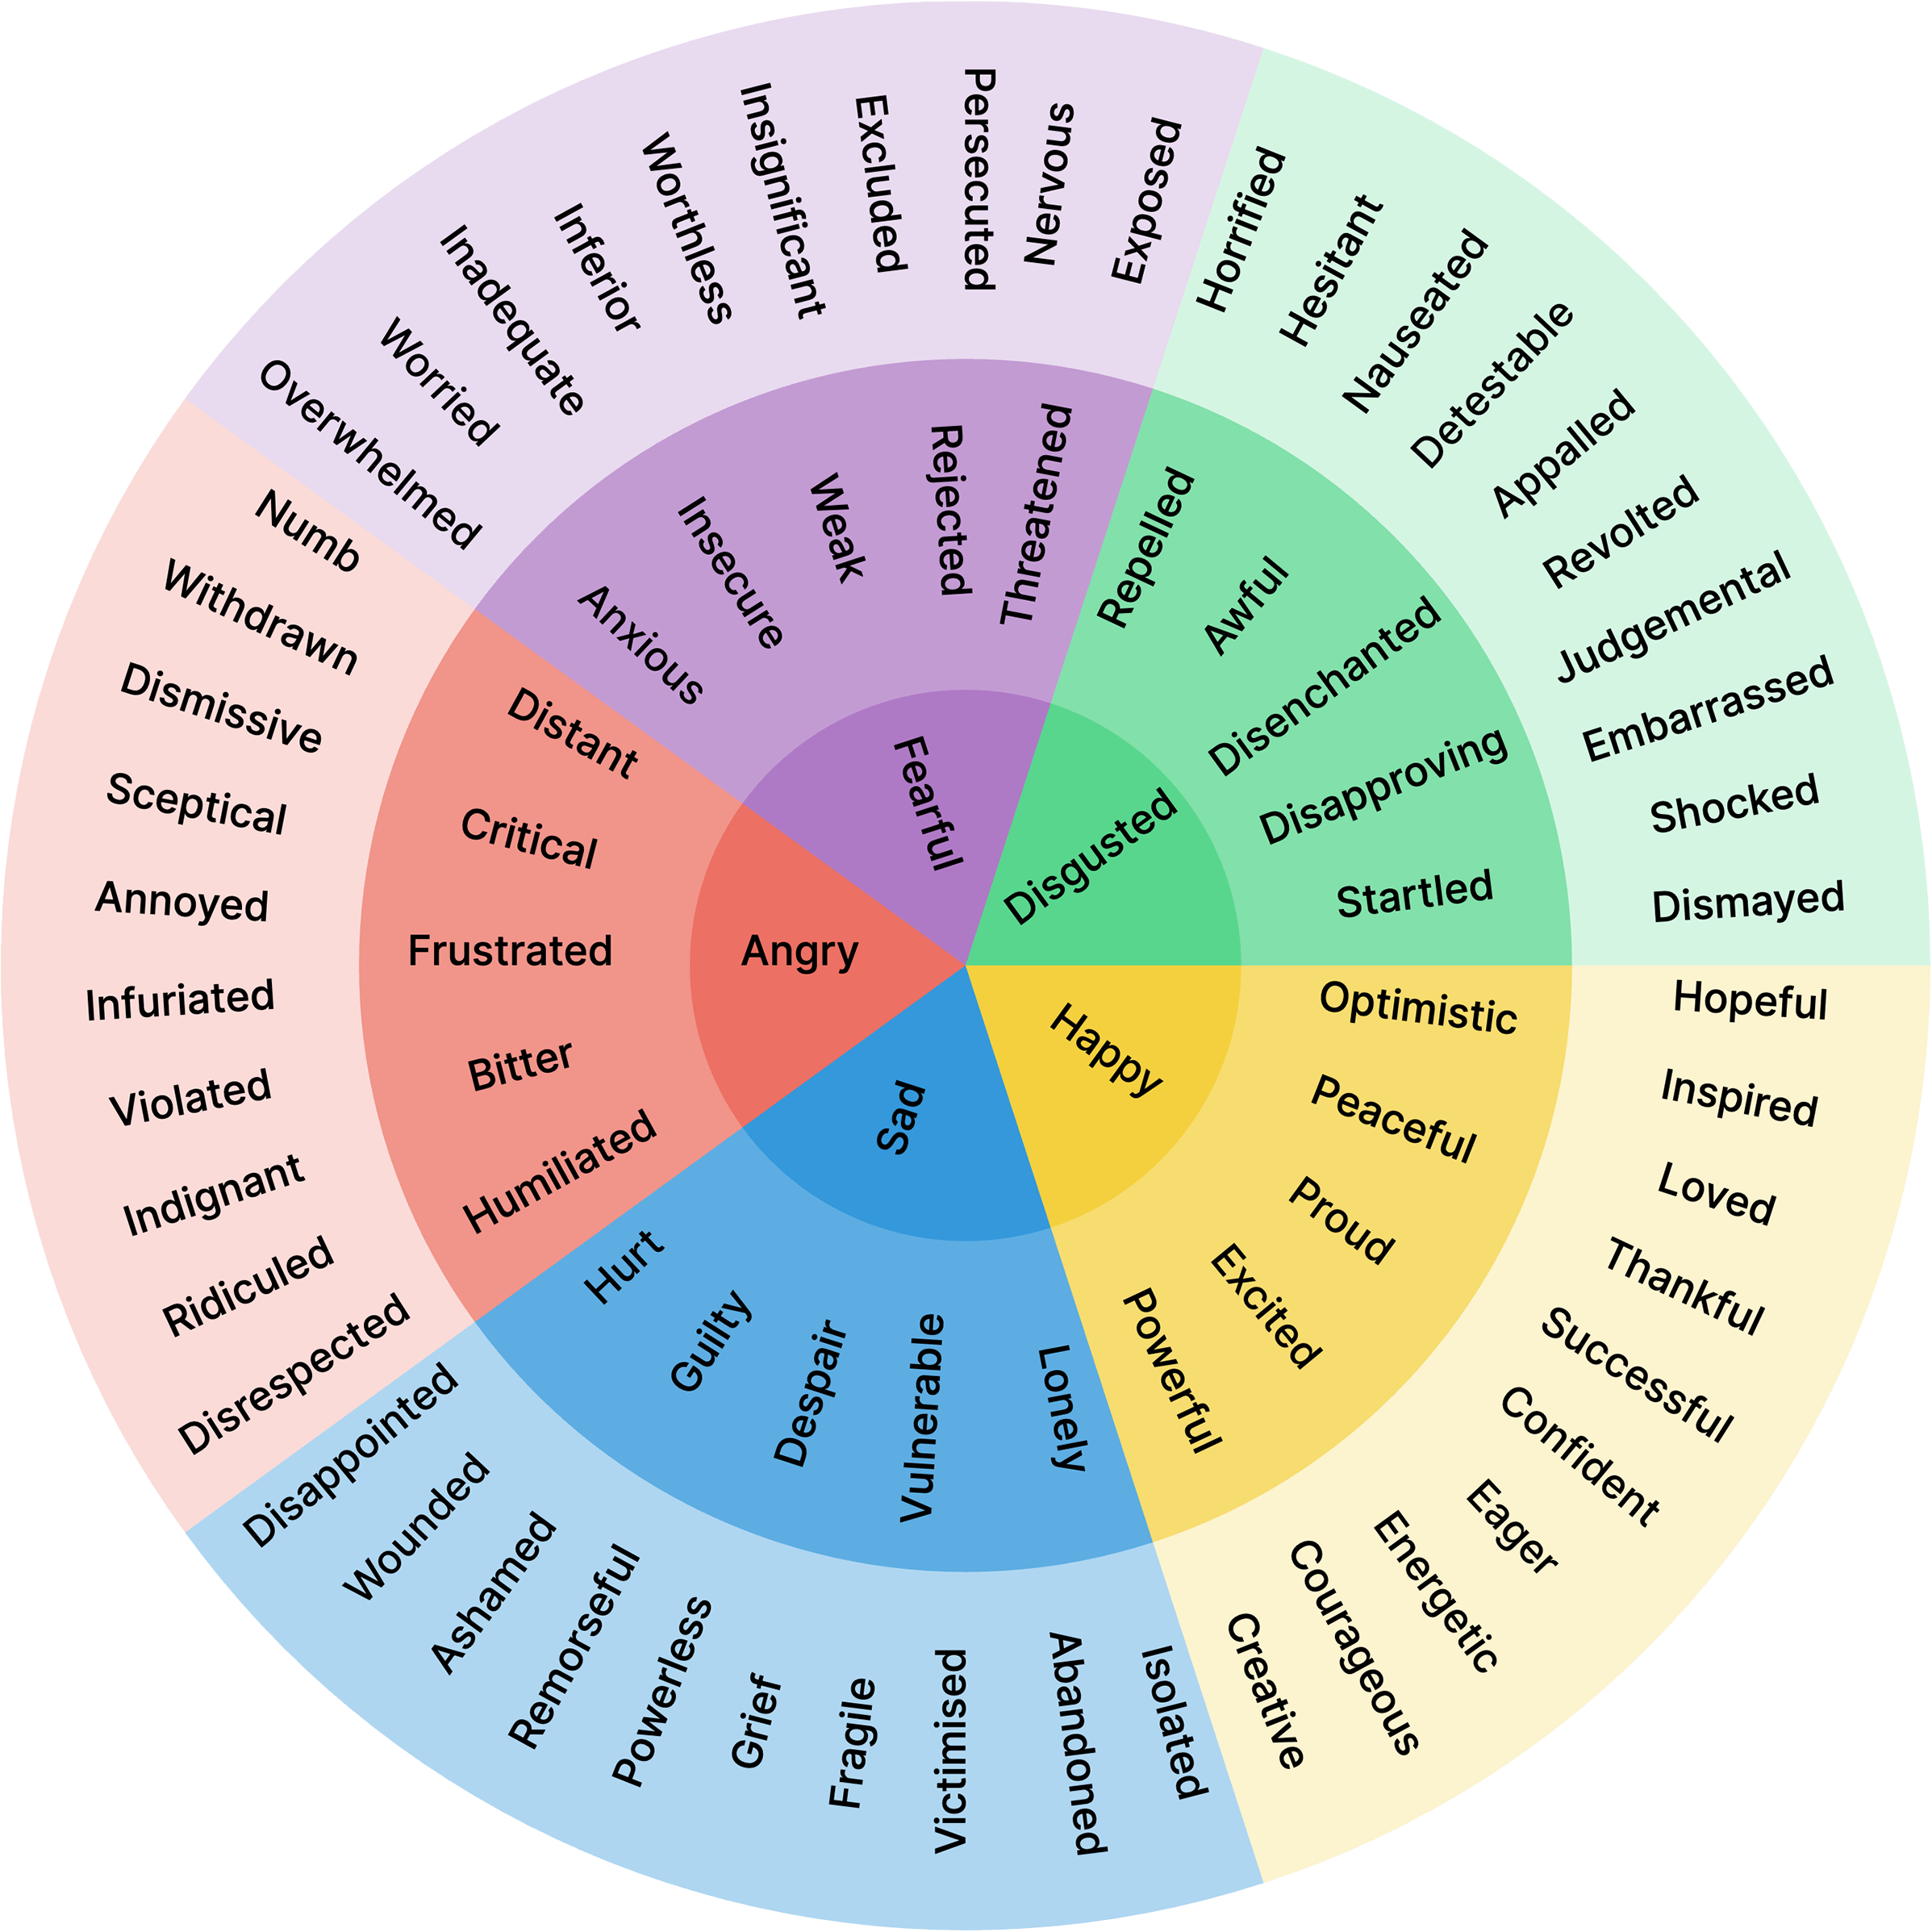
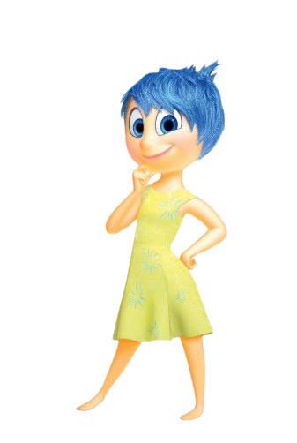
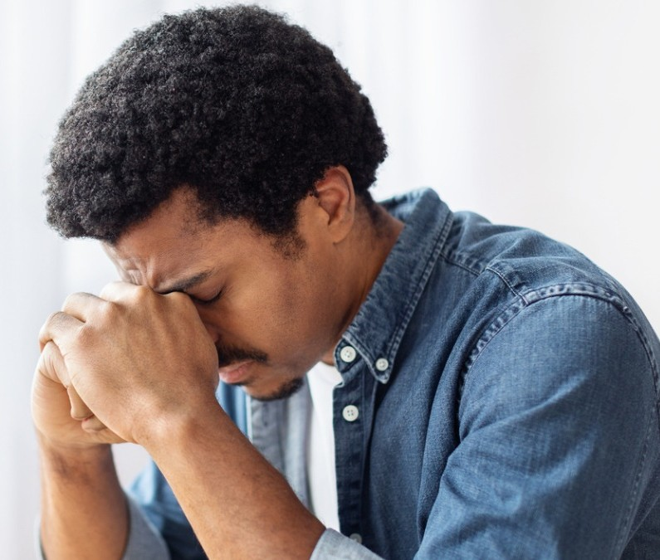
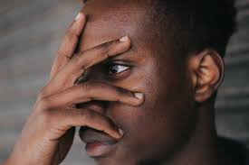
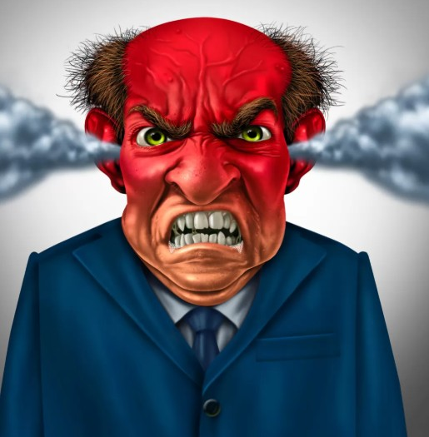
What Emotion do You Wish to Inspire in Your Audience?

Slide 12
Aristotle &Anger
“The precondition for anger is pain, because anyone in pain desires something.”
People who mock individuals as they are verbally abusive
What conditions inspire anger?
Are there particular people or types or people inspiring anger?
Are there specific things or situations that inspire anger?
When people who used to treat you well, change their behavior towards you.
When people are insensitive to your needs as it is a sign a disrespect and we do not neglect the people we care for.
People who oppose you are don’t pay you back as they may seem to be motivated by contempt.
Those your audience have deemed of “no consequence”

Slide 13
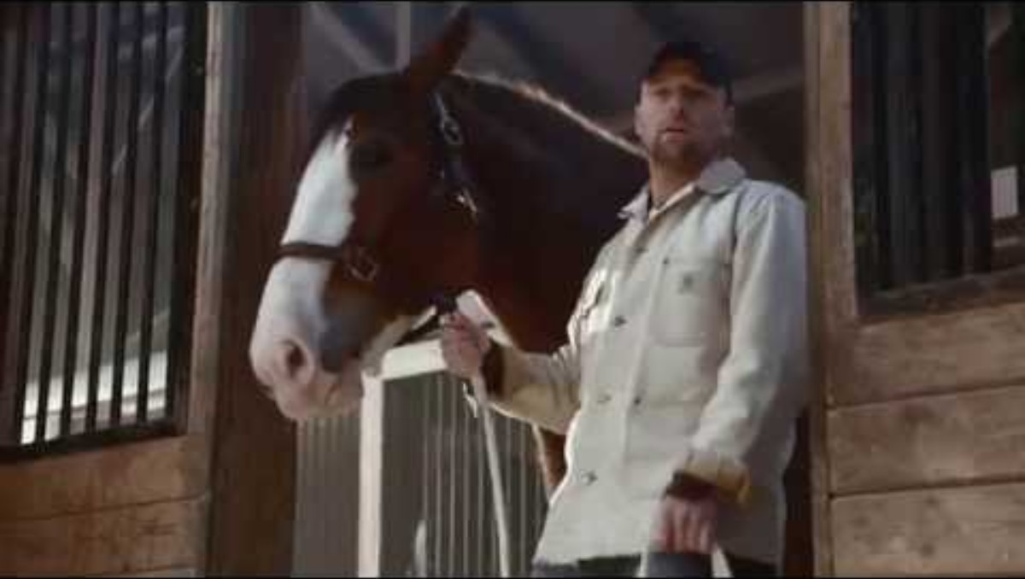
What Feelings Does this Inspire?

Slide 14
Logos

Slide 15
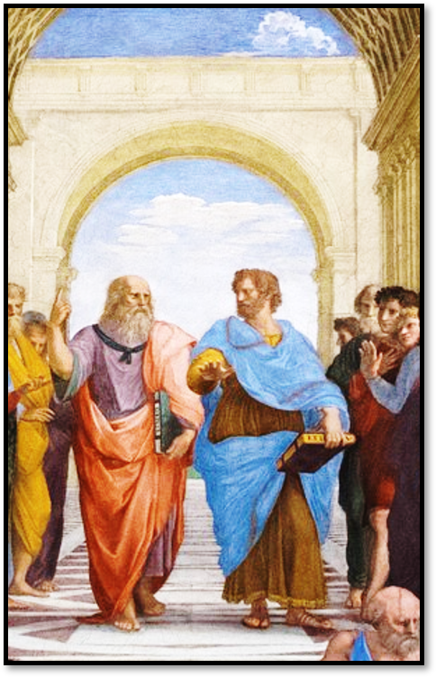
Persuasion Through argument
Proof by argument occurs when we use the persuasive elements of any give case to demonstrate the truth or the semblance of truth.

Slide 16
Reasoning in Rhetoric
Deduction
  A discussion in which, certain things having been laid down, something other than these things necessarily results through them
  Syllogism
    Major premise
    Minor premise
    Conclusion
Induction
  Movement from specific ideas or particular to universals
  Enthymemes
    Shared premised (audience + speaker)
    Speaker’s claim
    Audience completes the reasoning
      *The speaker does not have to take full responsibility for the claim

Slide 17

Examples:
She must be trustworthy since she is a doctor.
Major premise:
Vampires are immortal
Y (She) is an example of X (trustworthy)
IMPLIED: All doctors are trustworthy
*Mental inference made by the audience
Minor premise:
Dracula is a vampire
Conclusion:
Dracula is immortal
Children should not vote because they lack life experience
IMPLIED: Only those with sufficient experience should be permitted to vote in elections

